Slide 1
PATTERN RECOGNITION OF HANDWRITTEN NUMBERS
Aman Dalal Mugdha Srivastava Shivangi Goyal Utkarsh Malik
R100215007 R100215044 R100215065 R100215076
|December 2017|

Slide 2
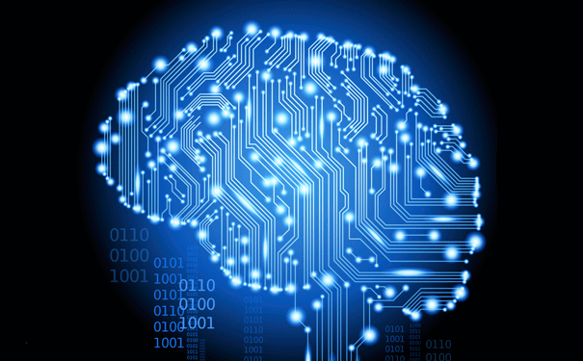
ABSTRACT
Every digital image is made-up with thousands of pixels that are stored in the form of a matrix.
Artificial Neural Networks are used in deciphering and differentiating patterns.
Pattern recognition branch of
Machine Learning.
Extraction of the information
given in the pixels will be performed.
|December 2017|

Slide 3
INTRODUCTION
Pattern Recognition is a programmed or learned ability to recognize patterns within data sets.
There are two types of pattern recognition
Supervised
Unsupervised
Plays an important role in fields like Computer vision , Image processing and Neural networks.
|December2017|

Slide 4
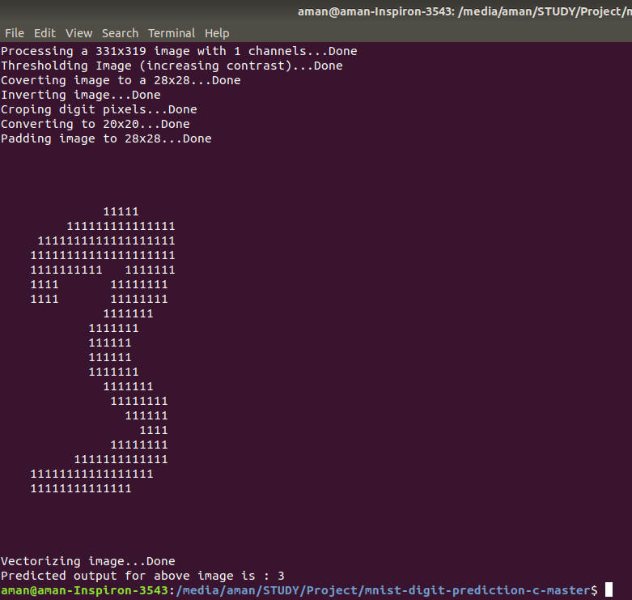
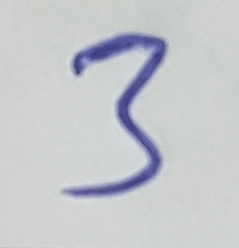
Recognized pattern:
|December 2017|

Slide 5
Feed Forward:
Biologically inspired classification algorithm.
Every unit in a layer is connected with all the units in the previous layer.
The weights on these connections encode the knowledge of a network.
The units in a neural network are also called nodes .
Data enters at the inputs and passes through the network, layer by layer, until it arrives at the outputs.
|December 2017|

Slide 6
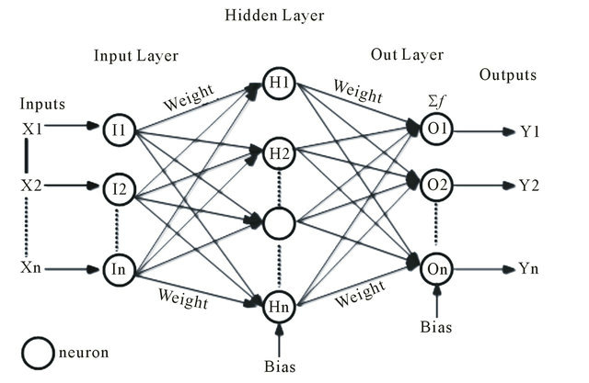
Feed Forward:
|December 2017|

Slide 7
NUMBER RECOGNITION STREAMS
Recognition of number from GUI: Here we add a drawing area on the interface on which we can draw any number .
Recognition of browsed image: A static representation of handwritten text is scanned and processed.
|December 2017|

Slide 8
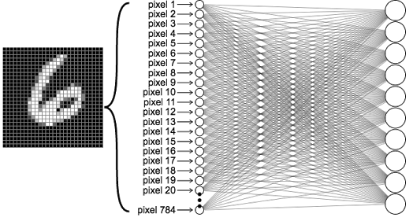
To determine how a system, for recognition of handwritten digits would be implemented on a modern system .
PROBLEM STATEMENT
To determine how a system for recognition of handwritten digits would be implemented on a modern system which do not recognize handwritten patterns.
|December 2017|

Slide 9
OBJECTIVES:
Main Objective: The purpose of this proposed work is to make computers recognize handwritten digits by using neural networks.
Sub Objectives:
Live demonstration of pattern recognition.
Use of best suitable algorithms and activation functions to increase the accuracy of prediction.
Make a efficient program to successfully browse an image from the computer and recognize it.
|December 2017|

Slide 10
METHODOLOGY:
Requirement Gathering and Analysis:
Software requirement analysis –
OS – Linux
Compiler - GCC
Atom or Sublime (Text Editor)
Design and Algorithm:
Feed Forward ^{[4]}
Back-propagation ^{[1],[2]}
Coding and Testing: Coding will be done after all the phases of requirement gathering and design.
|December 2017|

Slide 11
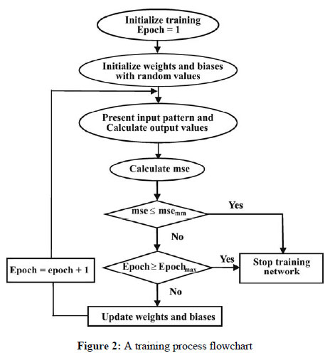
The Training Flow
|December 2017|

Slide 12
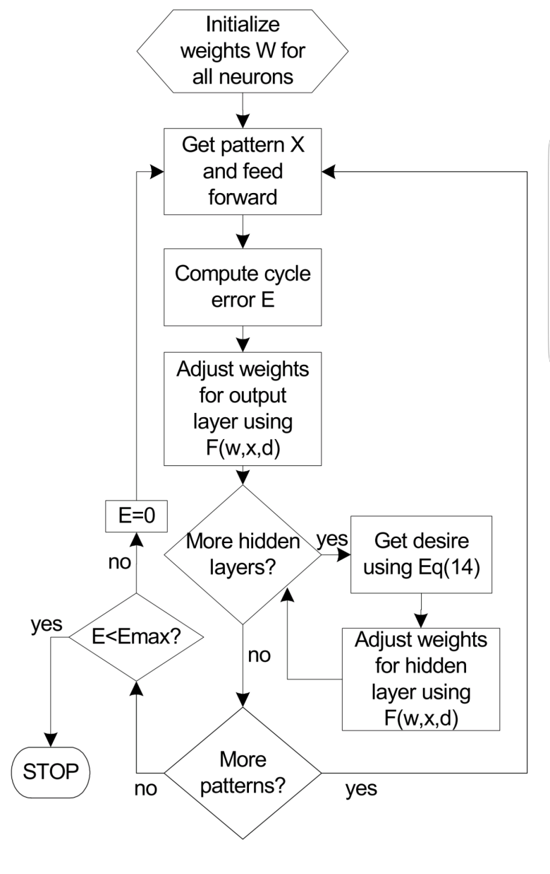
Back Propagation Algorithm
|December 2017|

Slide 13
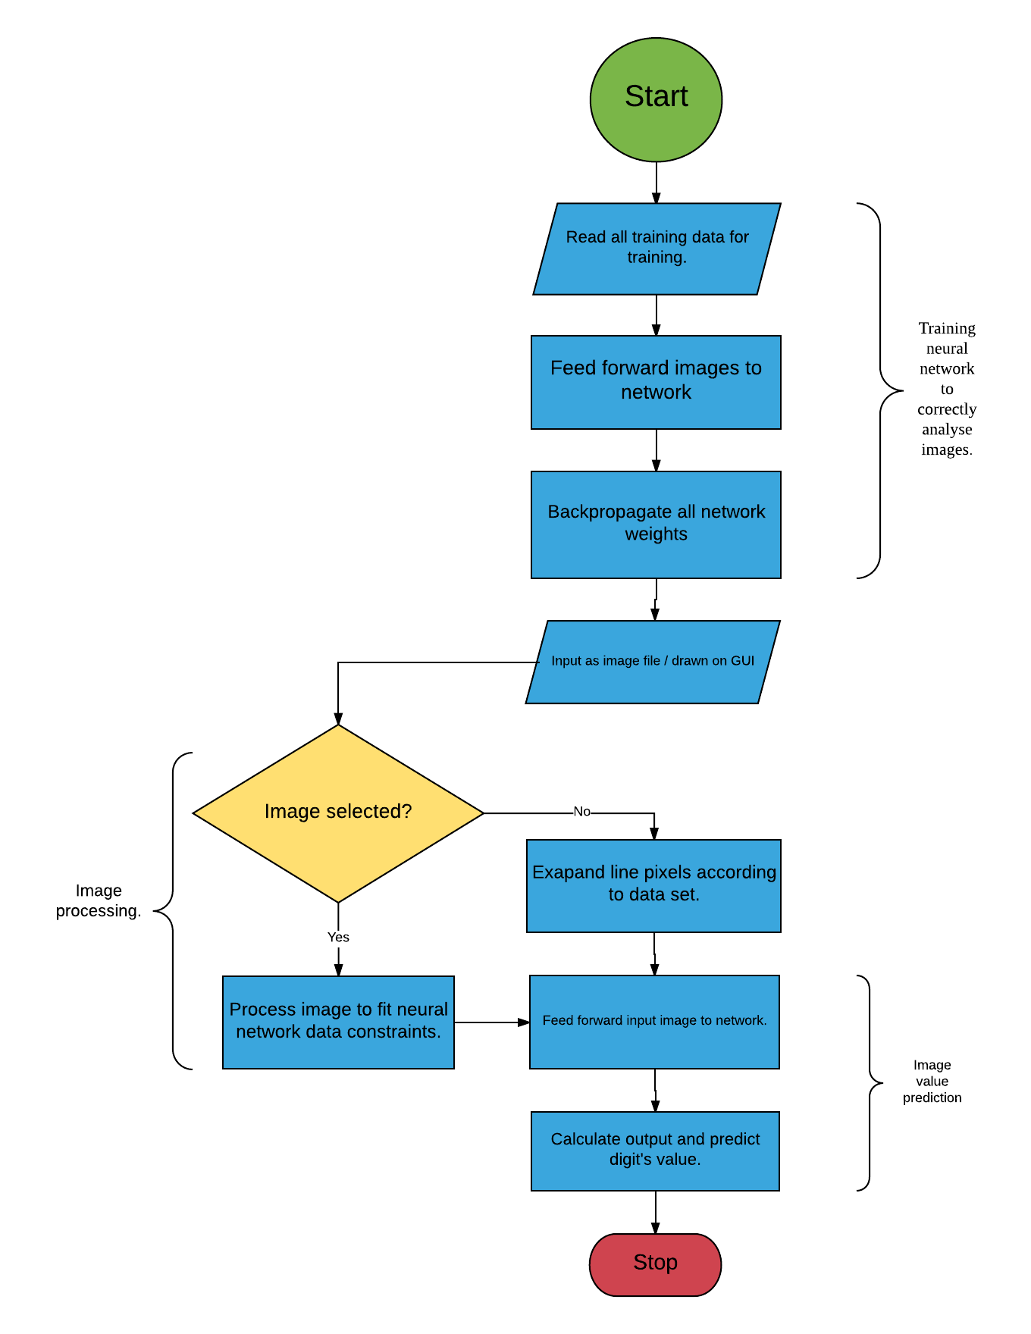
|

Slide 14
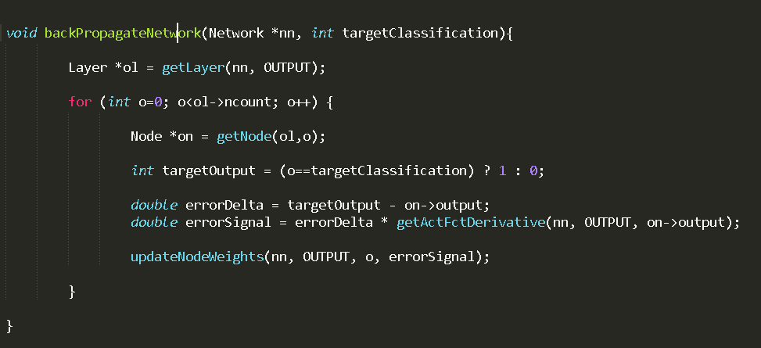
Some Important Functions:
|December 2017|

Slide 15
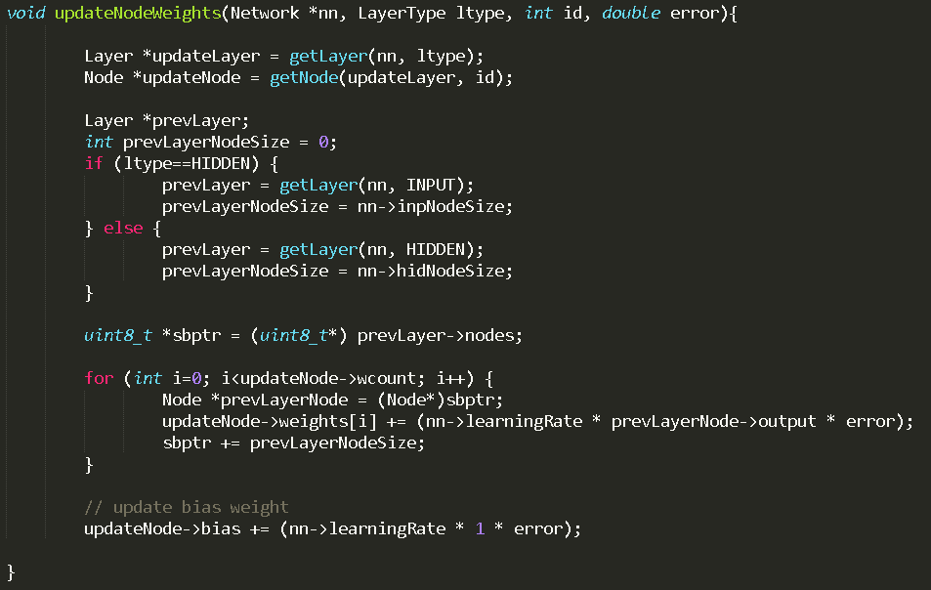
|December 2017|

Slide 16
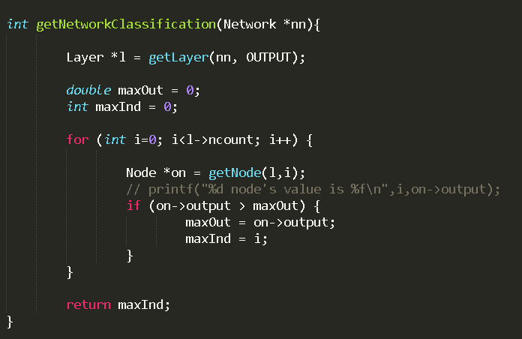
|December 2017|

Slide 17
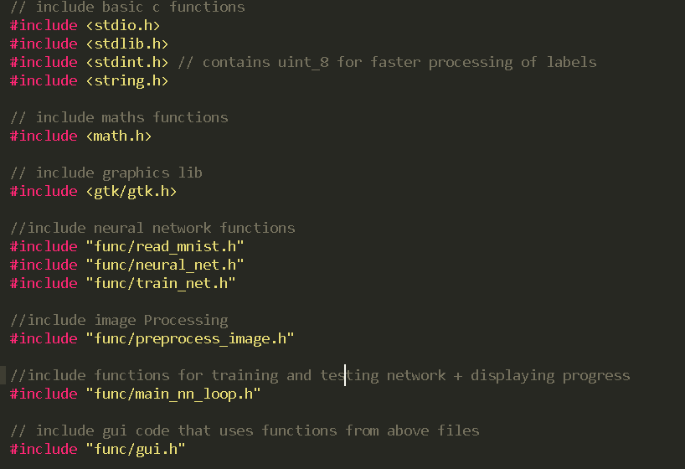
|December 2017|

Slide 18
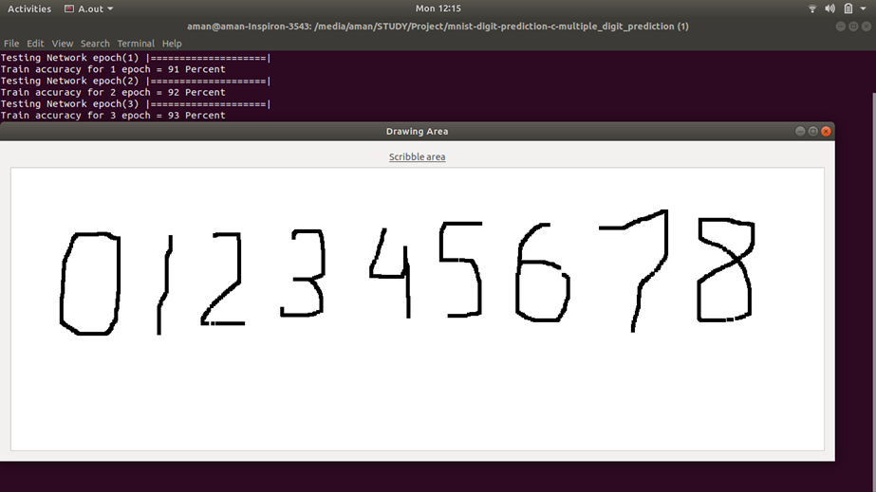
RESULT
Draw what ever digit you want in the area provided

Slide 19
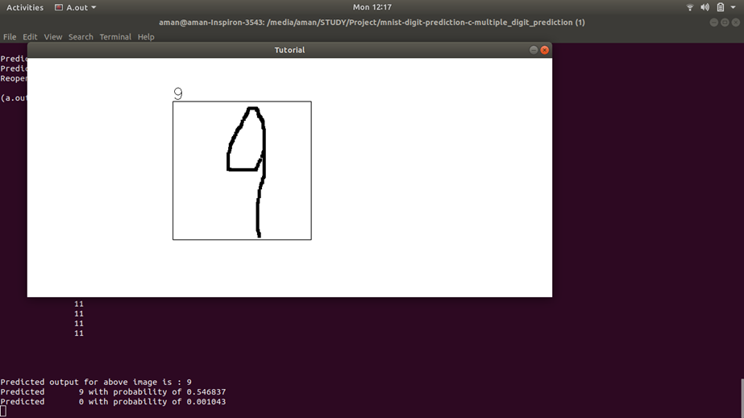
Results will be shown as follows

Slide 20
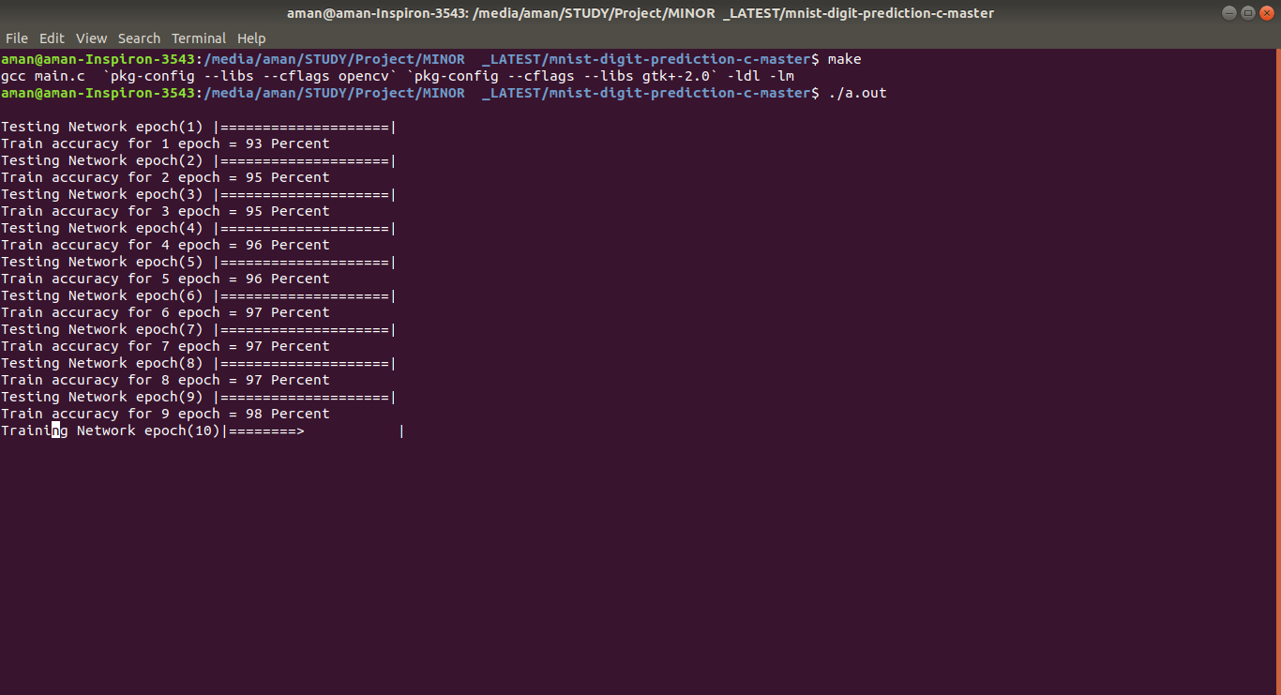
Highest accuracy we achieved till now..

Slide 21
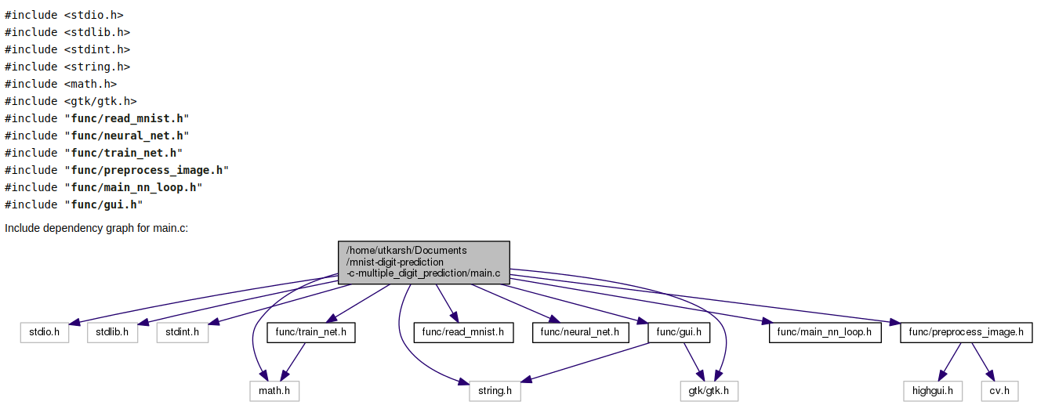

Slide 22
CONCLUSION
1)The system can continuously achieve the higher accuracy by training the neural networks with more improved data sets.
2) The activation functions - sigmoid, tanh, relu effectively helped in obtaining different values of accuracies with the accuracy of sigmoid function being the highest and amounting to a 98% (by extensive training). Testing the test set with the tanh function amounted to a value of 78% while relu amounted to an 82%.
3) It also made us realize that biological realism would impose entirely unnecessary constraints and hence, our system cannot be 100% accurate.
|December 2017|

Slide 23
LITERATURE REVIEW:
Arild Nøkland: The back-propagation algorithm is widely used for learning in artificial neural networks. This paper shows that adversarial training has a regularizing effect also in networks with logistic, hyperbolic tangent and rectified linear units.
A.T.C. Goh: Backpropagation neural networks are a product of artificial intelligence research. First, an overview of the neural network methodology is presented. This is followed by some practical guidelines for implementing back-propagation neural networks.
|December 2017|

Slide 24
Geoffrey G. Towell: Hybrid learning methods use theoretical knowledge of a domain and a set of classified examples to develop a method for accurately classifying examples not seen during training. A hybrid learning system should learn more effectively than systems that use only one of the information sources.
Shih-Chung B. Lo , Matthew T. Freedman: This paper talks about convolutional neural networks. Convolutional Neural Networks are very similar to ordinary Neural Networks: they are made up of neurons that have learnable weights and biases known as perceptrons!
|December 2017|

Slide 25
REFERENCES:
[1] Arild Nøkland, “Improving Back-Propagation by Adding an Adversarial Gradient” – Cornell University Library
[2] A.T.C. Goh, “Back-propagation neural networks for modeling complex systems” (“Artificial Intelligence in Engineering” Volume 9, Issue 3, 1995, Pages 143-151), School of Civil & Structural Engineering, Nanyang Technological University, Nanyang Avenue,
[3] Geoffrey G. Towell, “Knowledge-based artificial neural networks” (“Artificial Intelligence” Volume 70, Issues 1–2, October 1994, Pages 119-165), University of Wisconsin, 1210 West Dayton St., Madison, WI 53706,
[4]Shih-Chung B. Lo , Matthew T. Freedman, “Artificial convolution neural network for image pattern recognition” (“Neural Networks” Volume 8, Issues 7–8, 1995, Pages 1201-1214), 1-Georgetown University Medical Center, USA 2-University of Michigan Medical Center,
[5] Yann Le Cun, “THE MNIST DATABASE of handwritten digits”, Courant Institute, NYU Corinna Cortes, Google Labs, New York Christopher J.C. Burges, Microsoft Research, Redmond
[6] Web- Deep Learning Book http://www.deeplearningbook.org/
|December 2017|

Slide 26
Thank You You!
|December 2017|

